Slide 1
Airline Dataset Analysis
(PRE – PLACEMENT PROJECT)
BY AMAN VERMA

Slide 2
The project revolves around the analysis of an airline dataset, aiming to derive valuable insights from the wealth of information it contains.
By exploring various aspects such as passenger demographics, flight statuses, and geographic distribution, the analysis seeks to uncover patterns, trends, and key characteristics within the airline industry.
Through a combination of data exploration, cleaning, visualization, and interpretation, the project offers a comprehensive understanding of the dataset, providing actionable information for stakeholders in the aviation domain.
The visualizations and analysis conducted serve as tools for decision-makers to enhance operational efficiency, improve customer experiences, and make informed strategic decisions within the airline industry.
INTRODUCTION

Slide 3
The project likely aims to extract meaningful information from the airline dataset, uncover patterns, and present insights through various visualizations.
To understand some questions that needs to be explored:
Percentage of women.
Ages of Passengers.
Flight statuses.
Which are the top 5 countries with the most visits.
Which continent is most visited.
Top 10 Nationalities.
Top 10 Airport countries with most passengers.
What is the Flight status throughout the year.
Some few questions based on tableau and a dashboard to gain insights.
Tools Used and to understand :
The use of tools like Python, Pandas, NumPy, Matplotlib, Seaborn, Plotly Express and Os are some interactive tools and libraries to visualize data effectively.
OBJECTIVE

Slide 4
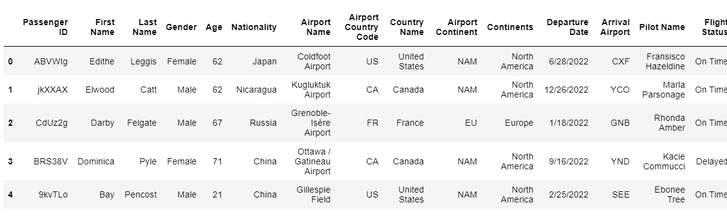
Data loading and Cleaning
Head of Data

Slide 5
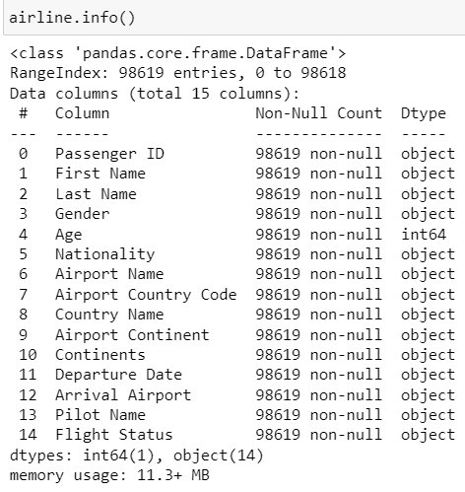

Info and Shape of Data

Slide 6
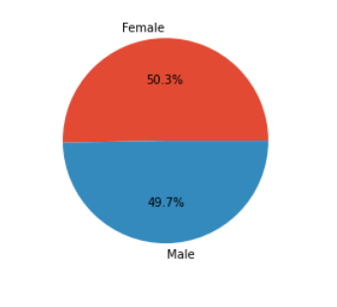
Percentage of Men & Women
Conclusion :
It can be seen that both the male and female percentage is almost same.

Slide 7
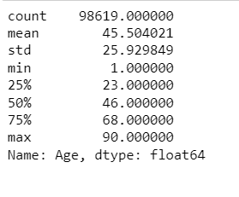
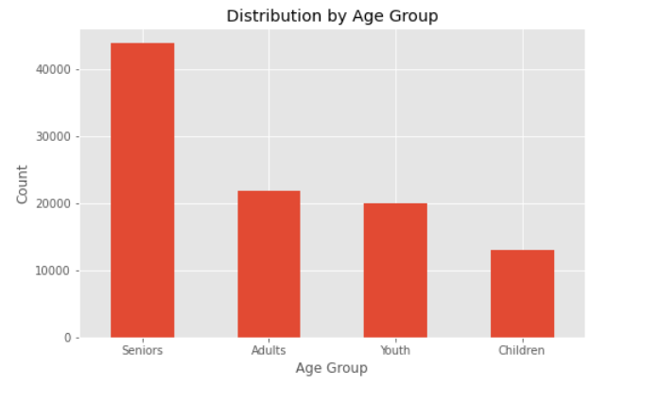
Ages of the Passengers
Conclusion :
Bins have been created as 10, 12, 30, 50 & 100 and labels has been given as Children, Youth, Adults and Seniors.

Slide 8

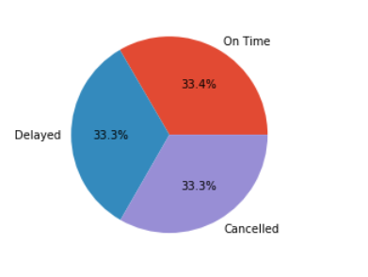
Flight Statuses
Conclusion :
This is the pie chart representation for the flight statuses and accordingly the % is shown.

Slide 9
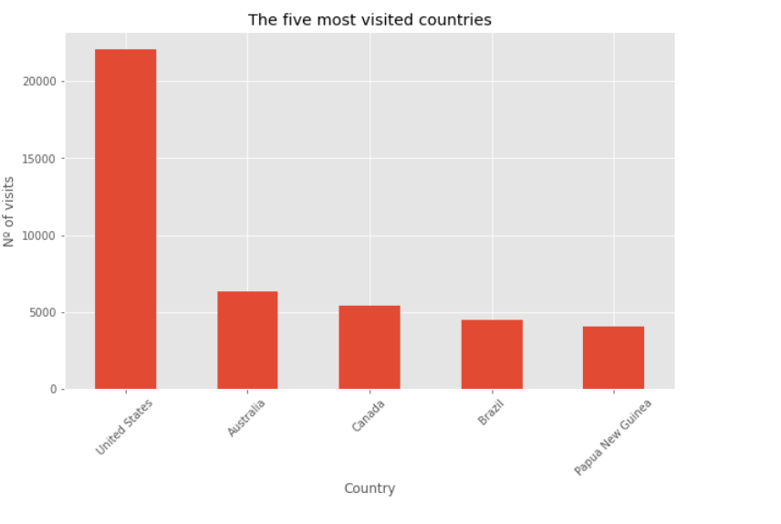
What are the Top 5 Countries with the most visits ?
Conclusion :
United States is the on the top with most visits and Australia is on 2nd top position

Slide 10
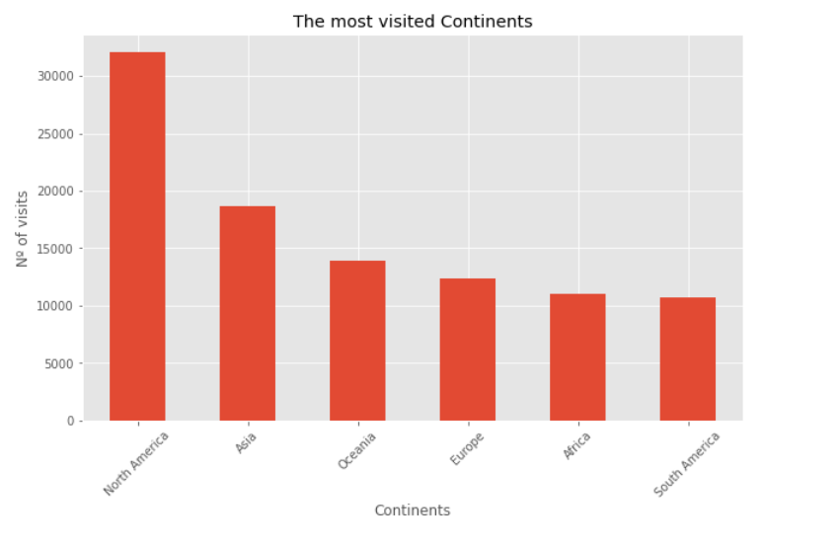
Which continent is most visited ?
Conclusion :
North America is the most visited continent and Asia is the 2nd most visited continent after N.A.

Slide 11
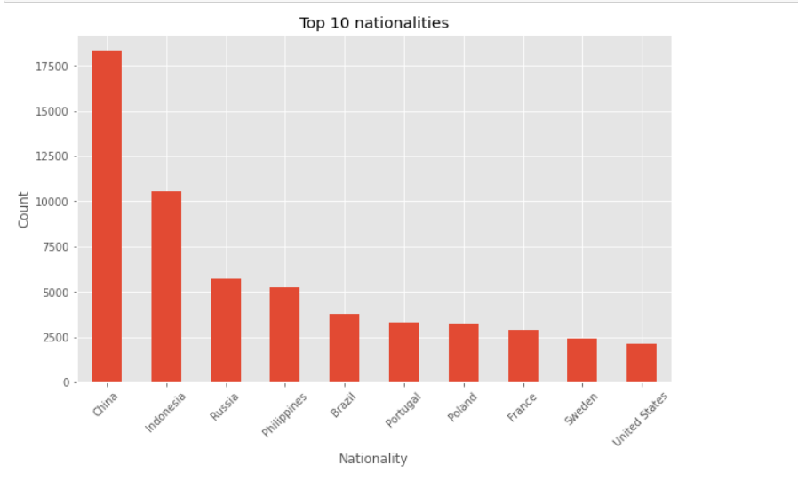
Top 10 Nationalities
Conclusion :
These are the top 10 nationalities that are found after extracting the data.

Slide 12
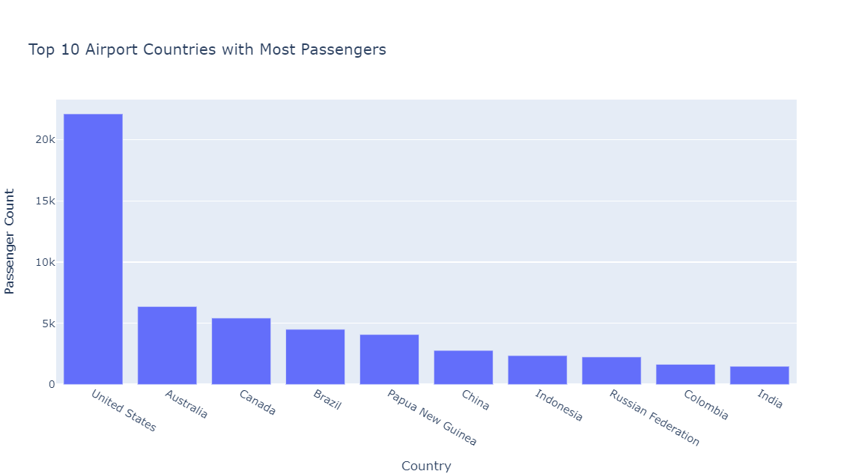
Top 10 Airport Countries with most passengers
Conclusion :
These are the top 10 Airport countries that is extracted and US is at the top.

Slide 13
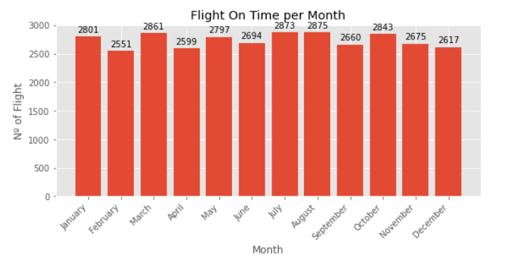
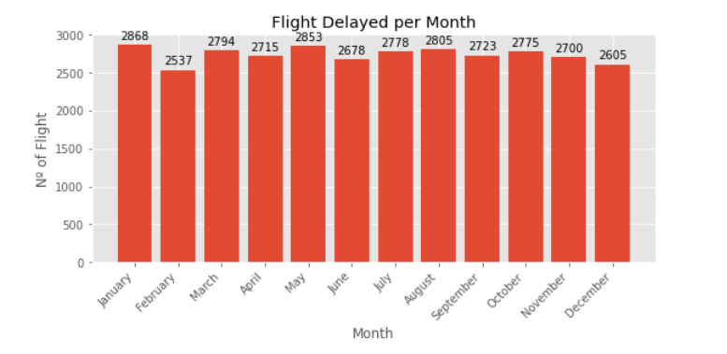
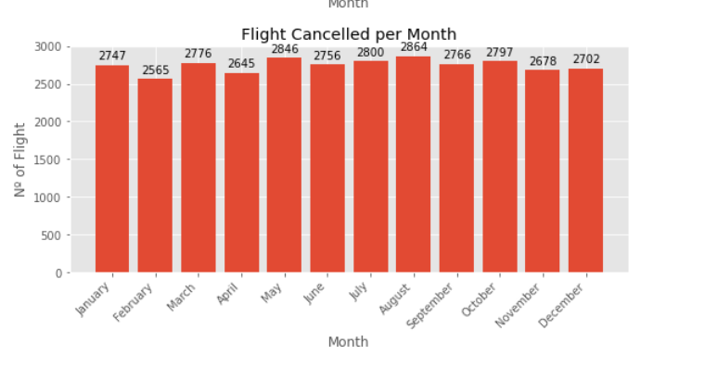
Flight status throughout the year
Month Wise Flight Time

Slide 14
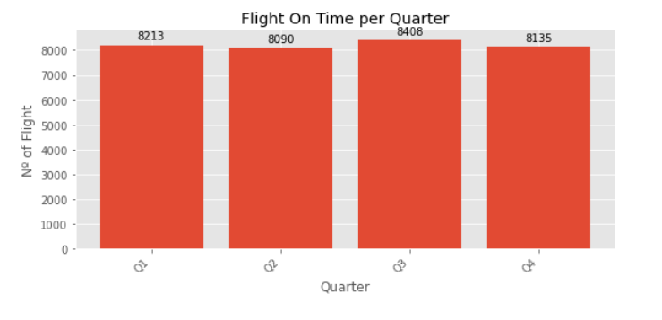
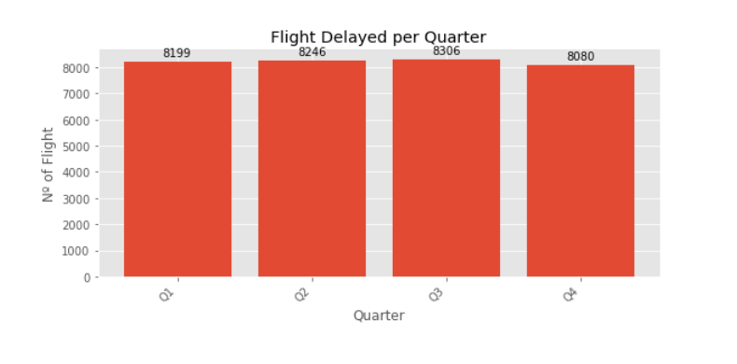
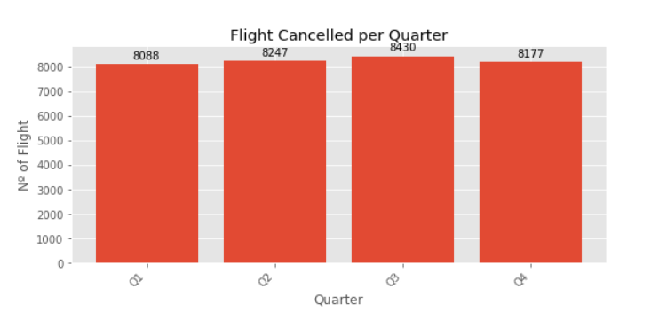
Flight Time Per Quarter

Slide 15
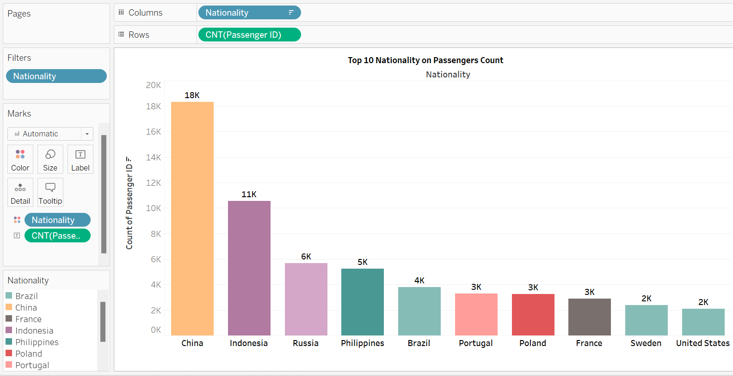
Top 10 Nationality on Passenger’s Count
Conclusion :
Extracted top 10 names of nation’s that has more count of passengers.

Slide 16
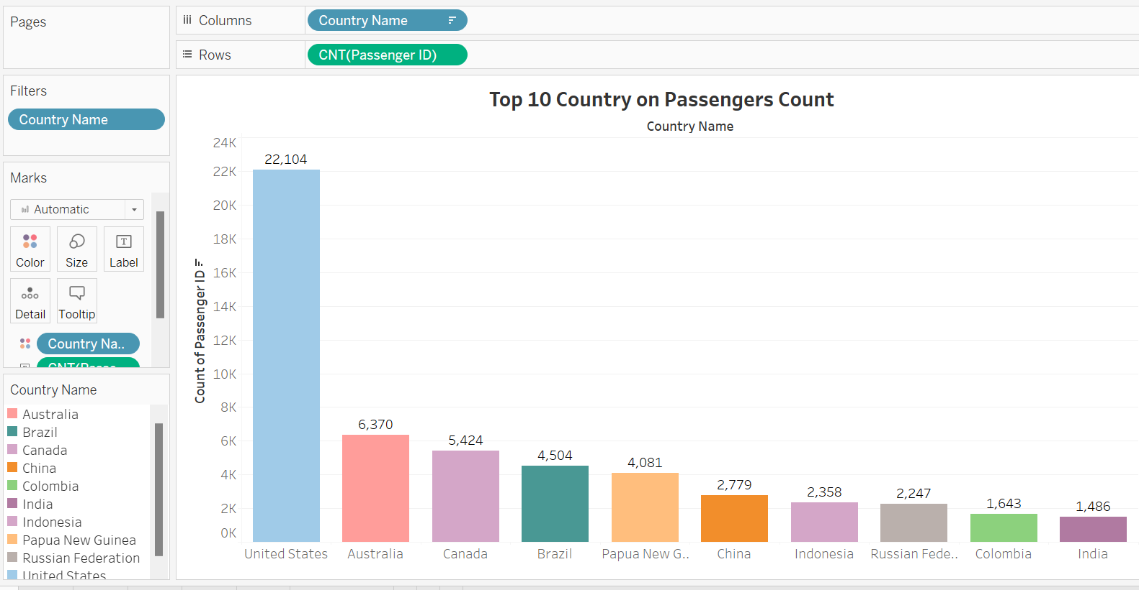
Top 10 Country based on Passenger Count
Conclusion :
These top 10 countries are extracted based on the counts of passengers.

Slide 17
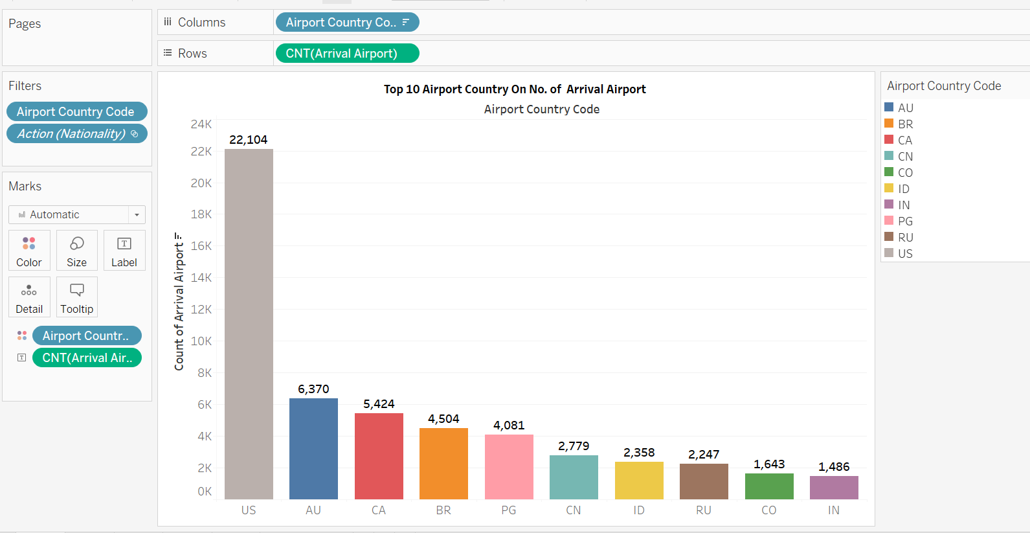
Top 10 Airport Countries based on No. of Arrival Airport
Conclusion :
These were the Top 10 Country codes of Airport based on the number of arrival airport.

Slide 18
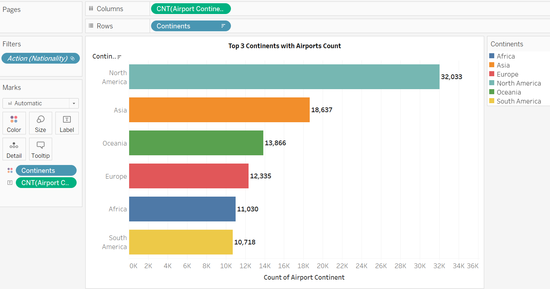
Top 3 Continents that has more no. of Airports
Conclusion :
North America, Asia and Oceania are the top 3 continents that has more no. of airports.

Slide 19
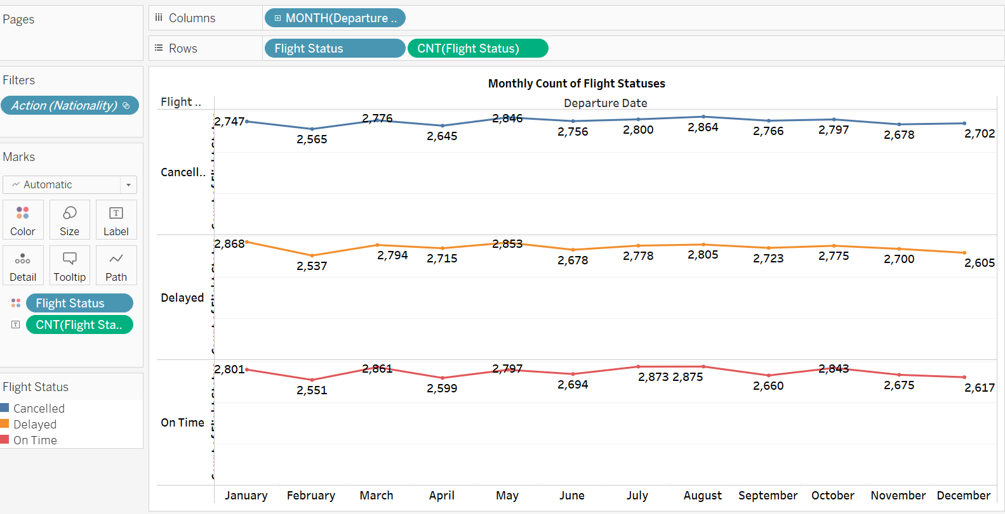
Monthly count based on Flight Statuses
Conclusion :
According to the months, the counts of different flight statues is shown here.

Slide 20
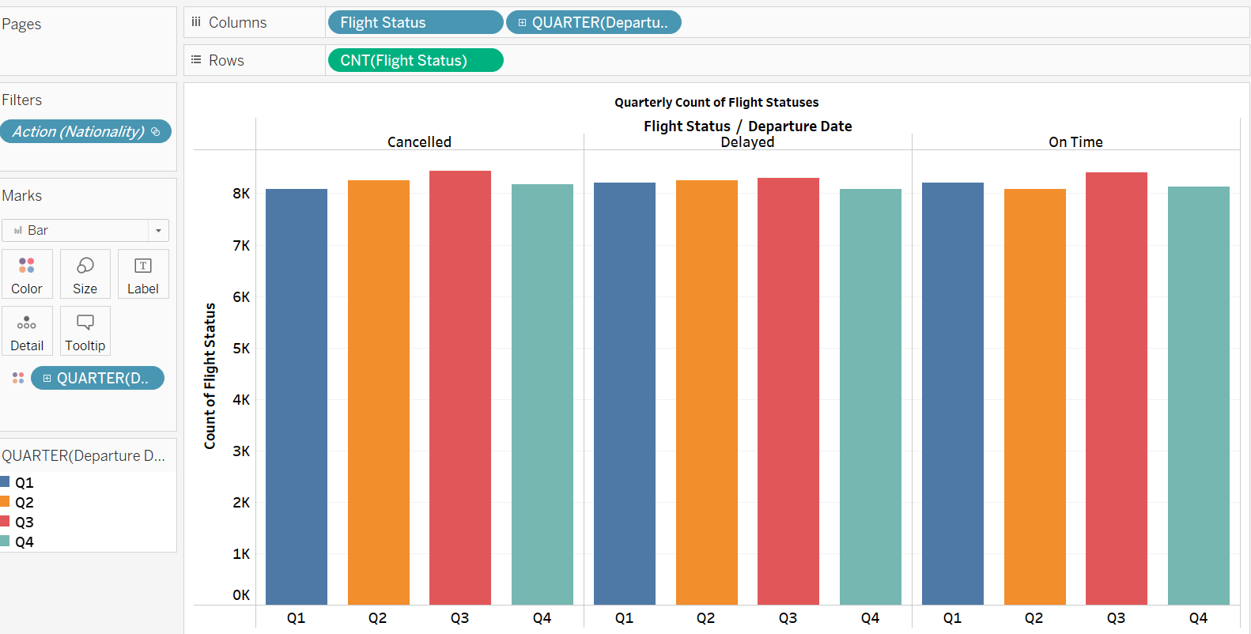
Count of Flight statuses Quarterly based
Conclusion :
Quarter 3 has most count in all three different flight statuses.

Slide 21
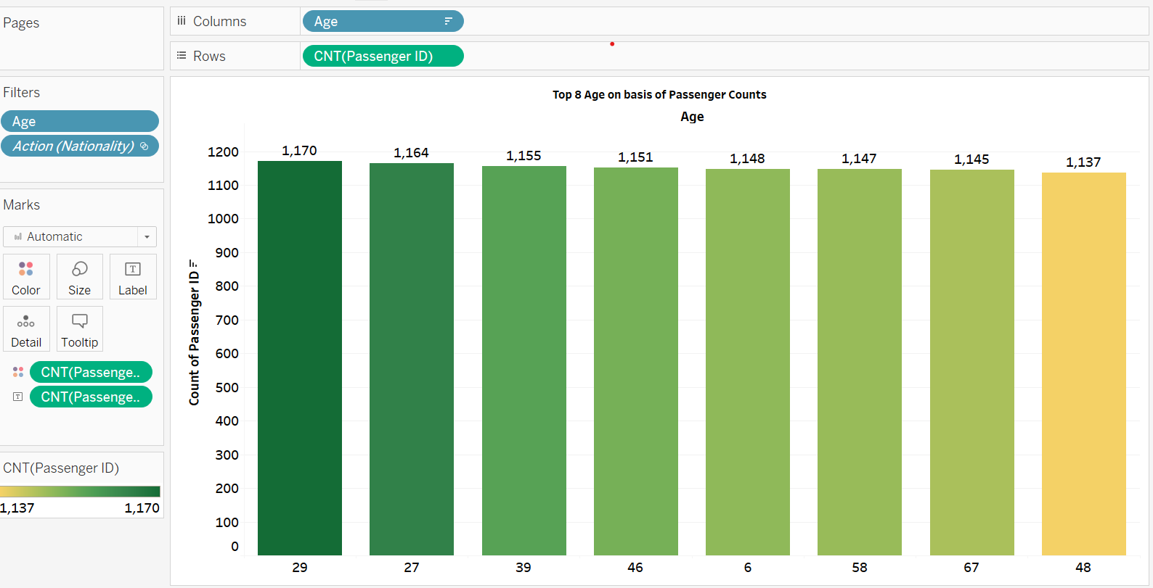
Top 8 Age that holds more count of passengers
Conclusion :
These are the top 8 age that holds more count of passengers.

Slide 22
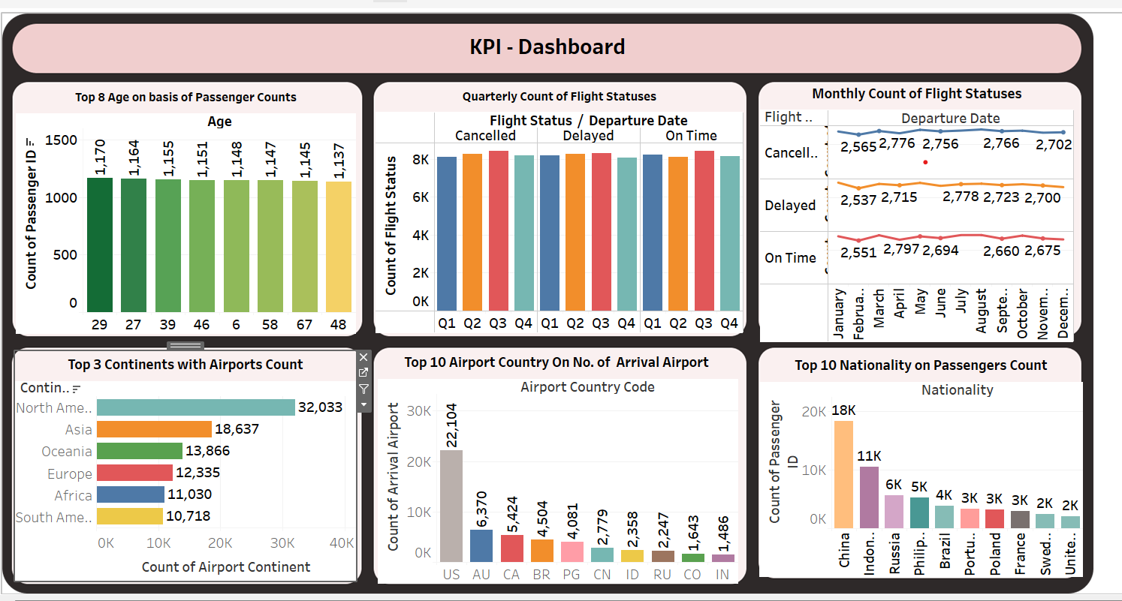
Dashboards that will help gain insights at one place

Slide 23
Data Cleaning has been done after loading the data in the Jupyter Notebook which has 98619 rows and 15 columns.
After analyzing the data, it is found that percentage of Male and Female passengers are almost same.
The senior group passengers are more among all age groups ( Senior, Children, Youth And Adults).
Flight Status : It was found that there was almost equal distribution of % in On Time, Cancelled and Delayed status.
Top 5 Visited Countries were US, Australia, Canada, Brazil, Papua new Guinea. Top Visited continents were North America, Asia, Oceania etc. Top Nationalities : China, Indonesia, Russia are top 3 Nationalities.
Through multiple bar graphs, Flight Status on monthly in which Feb. month is low season for flights and on Quarterly basis 3rd quarter shows most of the flight statuses Ontime, Delayed and cancelled.
Prepared some few questions on Tableau and the created dashboard for insights.
Conclusions

Slide 24
Presented By :
Aman Verma
THANKYOU
Mentor :
Sharayoo Dixit

